Slide 1
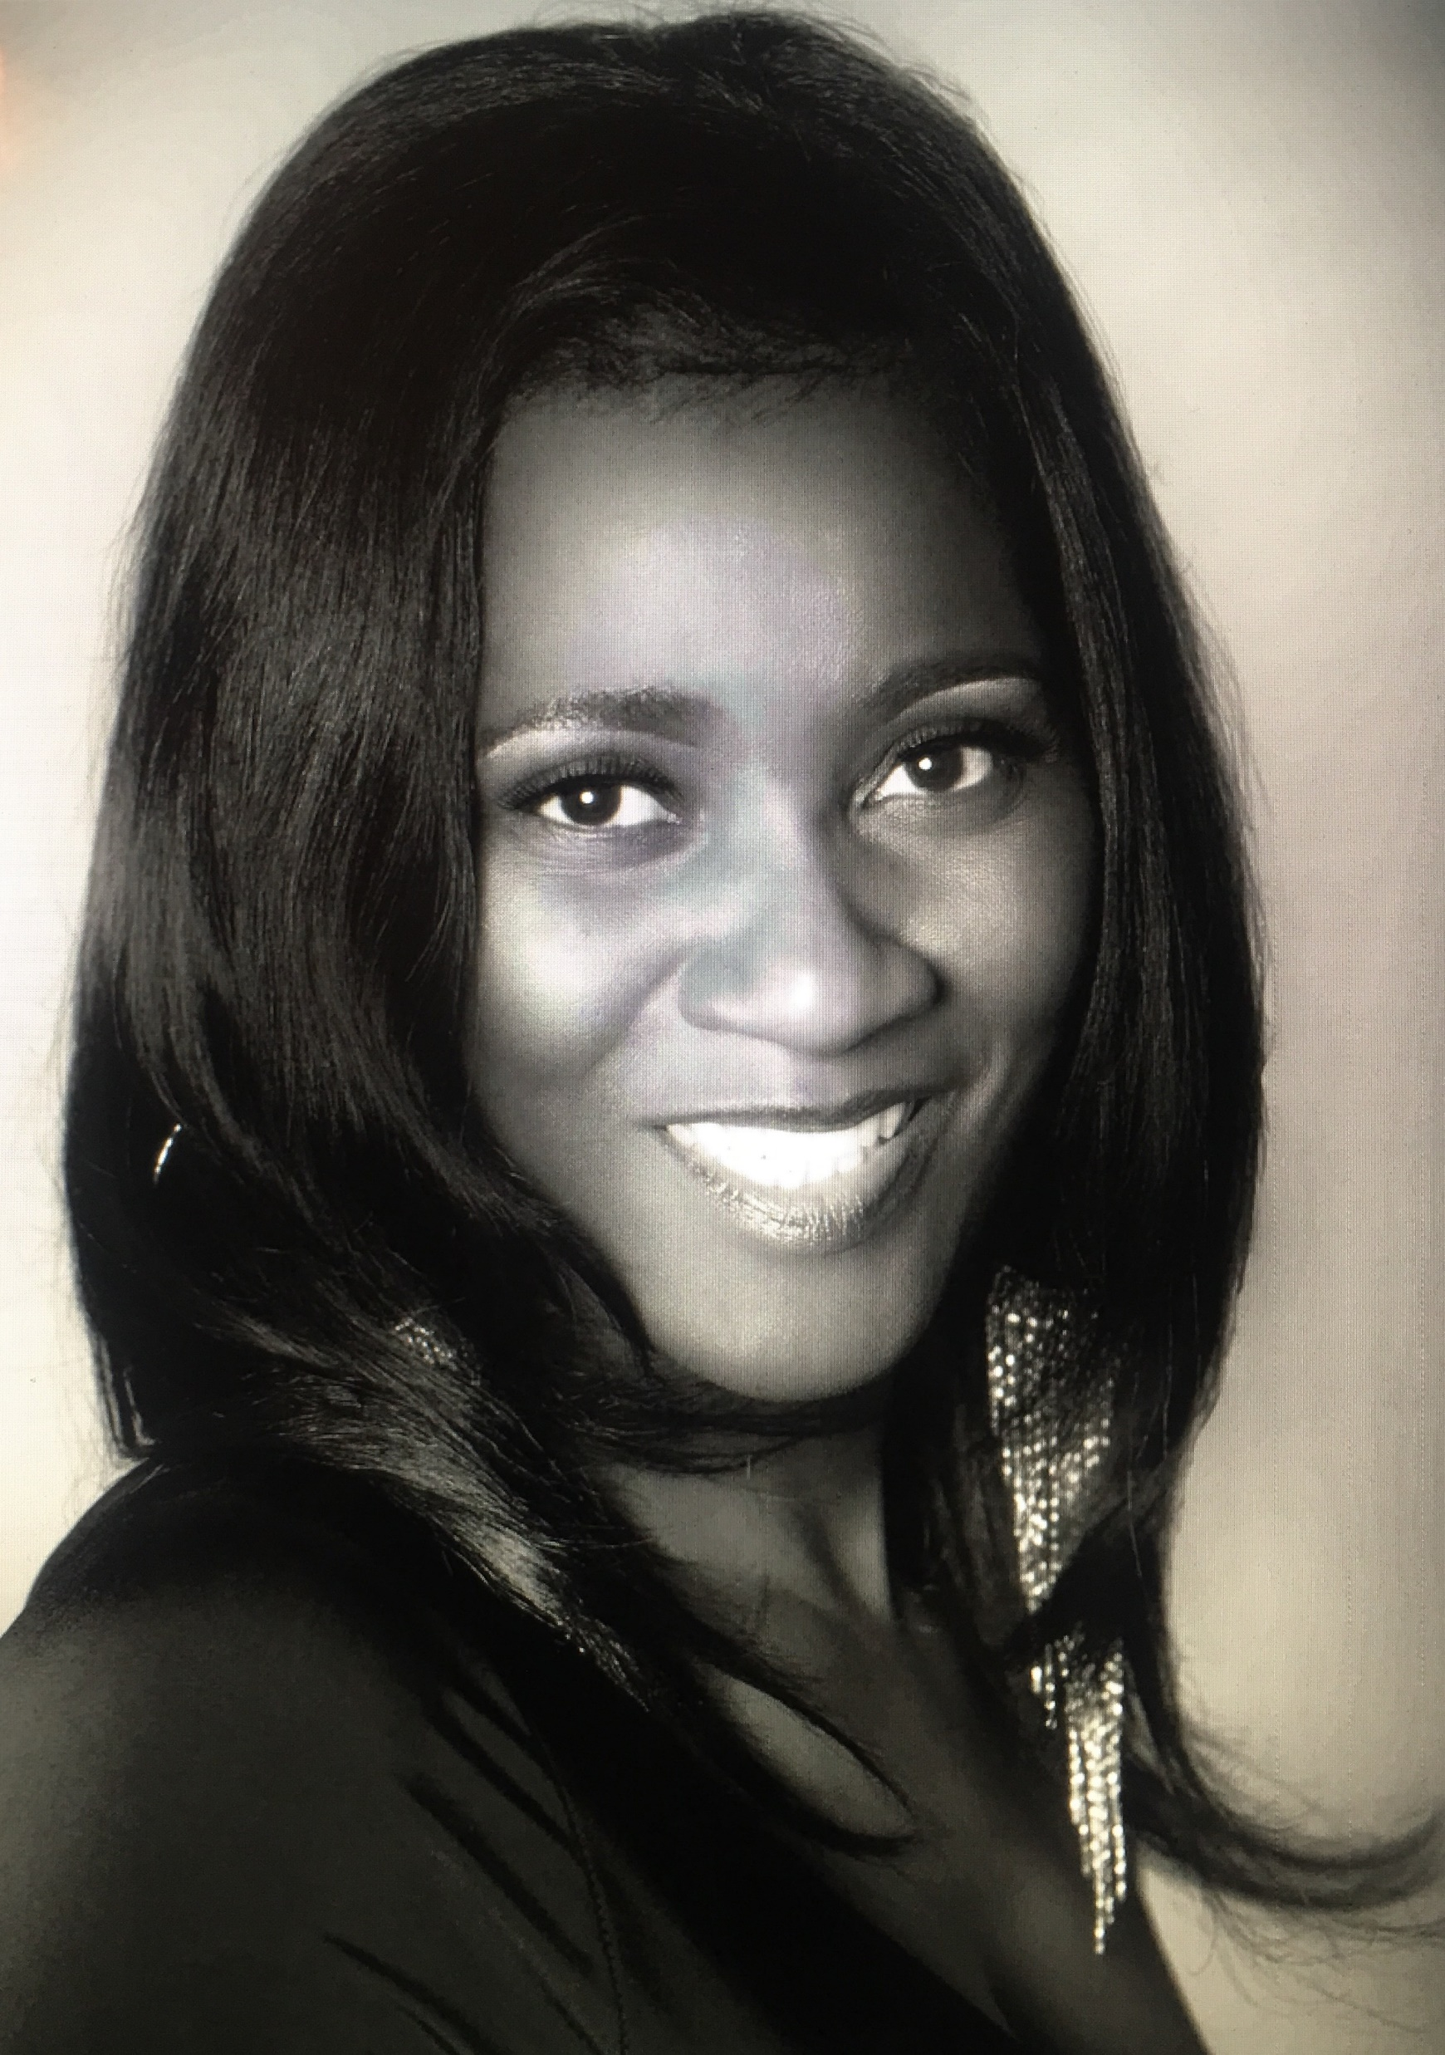
Meet our Registrar
Mrs. C. Shy
The B.E.S.T. Academy 6-12
1190 Northwest Drive, NW
Atlanta, Georgia 30318
404-802-4950
BestHSRecords@atlanta.k12.ga.us

